Slide 1
Infotact Solutions-
Data Analytics Internship (2 months)
Project 1: Sales Data Analysis and Dashboard Project Summary
By Richa Mudi

Slide 2
Problem Statement
Analyze a company’s historical sales data to identify key revenue drivers, seasonal trends, and suggest, actionable improvements, visualize insights, through interactive dashboards.

Slide 3
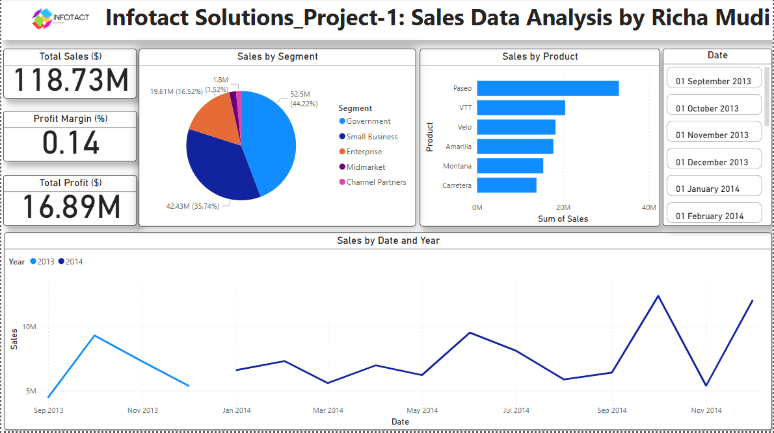
Project Summary

Slide 4
Overview:
This dashboard provides a comprehensive view of sales performance across different products, segments, and time periods. It captures key financial metrics including total sales, total profit, and profit margin, and visually breaks down performance using charts and graphs for quick insights.

Slide 5
Key Metrics:
Total Sales: $118.73M
Total Profit: $16.89M
Profit Margin: 14% (Calculated using DAX: Profit Margin = DIVIDE(SUM(Financials[Profit]), SUM(Financials[Sales])))

Slide 6
Key Findings:
1. Top-Performing Product
Paseo generated the highest sales among all products, contributing significantly to the revenue.
VTT and Velo followed closely, while Carretera had the lowest sales.

Slide 7
2. Sales by Segment
Government and Small Business are the top-performing segments.
Government: $52.5M (44.22%)
Small Business: $42.43M (35.74%)
Channel Partners and Midmarket have the least contribution.
3. Sales Trend Over Time
Noticeable sales peaks in September 2013, May 2014, and November 2014.
Volatility in sales suggests seasonality or campaign-driven spikes.
The sales trend shows strong year-end performance in 2014.

Slide 8
Recommendations:
Focus on Top Products:
Increase marketing and production efforts for high-performing products like Paseo and VTT.
Conduct analysis on underperforming products (e.g., Carretera) to identify improvement opportunities or consider discontinuation.

Slide 9
2. Target High-Value Segments:
Prioritize Government and Small Business segments in future campaigns.
Explore reasons behind the low performance of Channel Partners and evaluate support strategies.
3. Seasonal Campaign Planning:
Align sales and marketing activities with high-performing periods (like Q3 & Q4) to maximize revenue.
Analyze the factors behind monthly fluctuations to reduce unpredictability.

Slide 10
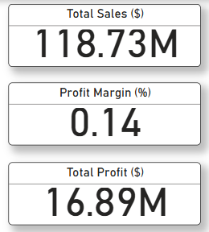
Insights:
What it shows: Displays the total sum of all sales in the dataset, i.e., $118.73M.
Fields used: SUM(Financials[Sales])
What it shows:
Displays the profit margin percentage, i.e., 14%, indicating profitability.
Fields used:
DAX measure: Profit Margin = DIVIDE(SUM(Financials[Profit]), SUM(Financials[Sales]))
What it shows: Displays total profit earned across all transactions, i.e., $16.89M.
Fields used: SUM(Financials[Profit])

Slide 11
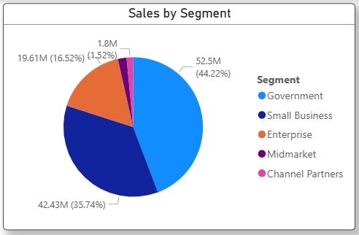
What it shows: Visual breakdown of sales contribution by business segment (e.g., Government, Small Business, Enterprise).
Fields used:
Legend: Financials[Segment]
Values: SUM(Financials[Sales])

Slide 12
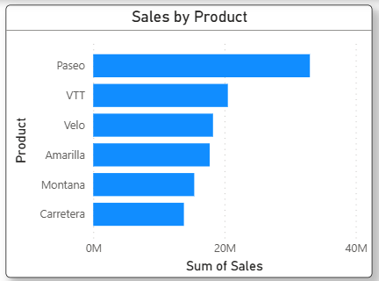
What it shows: Ranks products based on total sales. Paseo is the top seller.
Fields used:
Axis: Financials[Product]
Values: SUM(Financials[Sales])

Slide 13
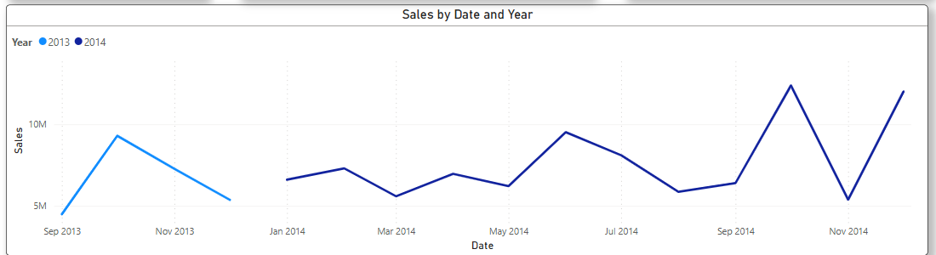
What it shows: Trends in monthly sales over time, comparing 2013 and 2014.
Fields used:
Axis: Financials[Date] (time-based)
Legend: Financials[Year]
Values: SUM(Financials[Sales])

Slide 14
Thank You!

